Slide 1
-2022- New Mexico State 4-H Photography Contest

Slide 2
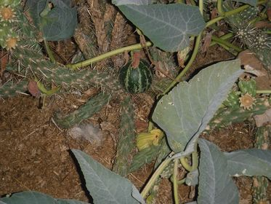
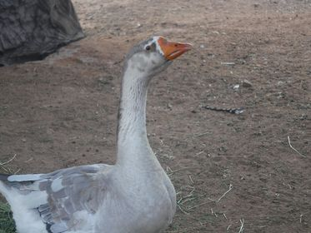
-Animals-
“Touch”
Alicia S. Dona Ana
“Goose”
Alicia S. Dona Ana

Slide 3
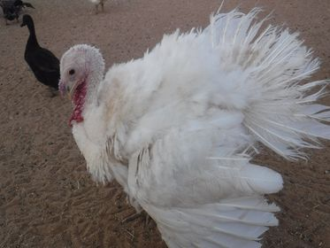
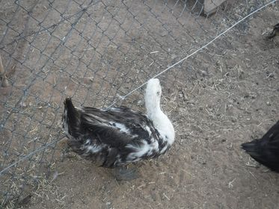
“Frosty”
Alicia S. Dona Ana
“Look Away”
Ashley S. Dona Ana

Slide 4
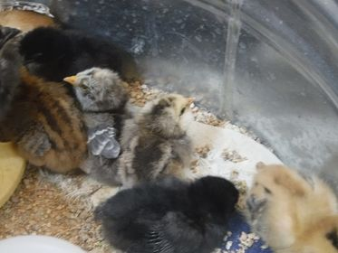
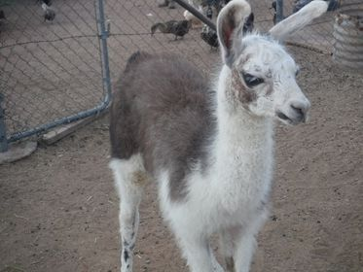
“Baby Chicks”
Ashley S. Dona Ana
“Baby Jasmine”
Austin S. Dona Ana

Slide 5
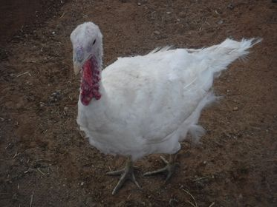
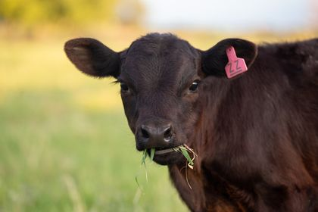
-Second In Animals-
“Frosty the Turkey”
Austin S. Dona Ana
“Dogie Sue”
Breanne L. Socorro
2nd

Slide 6
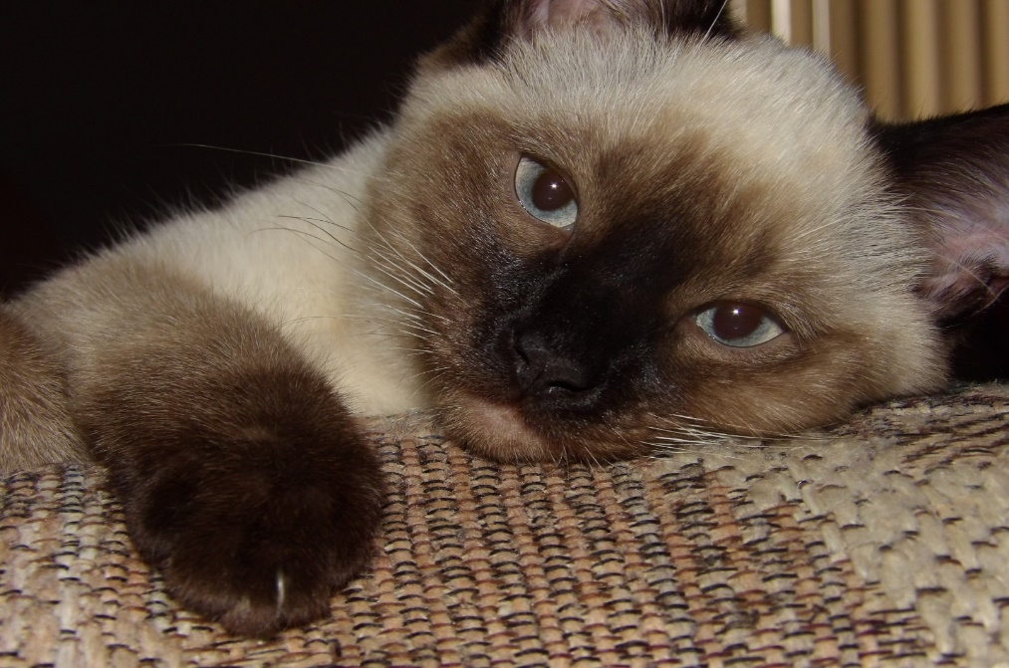
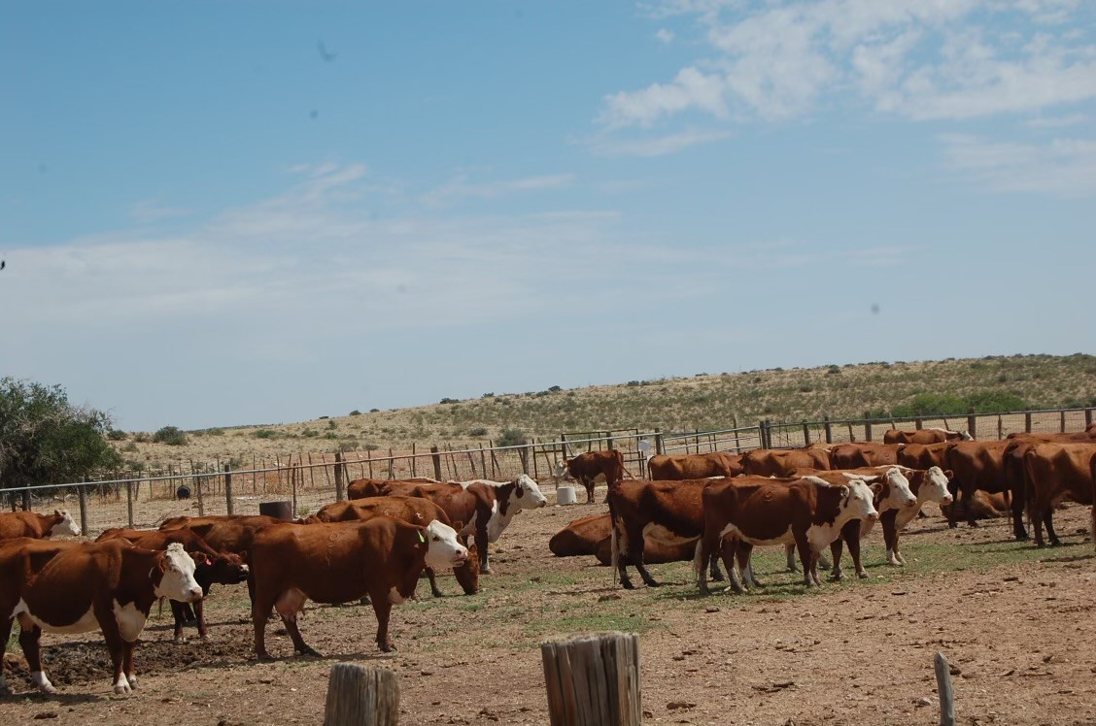
“Complete Relaxation”
ChristiAna T. Bernalillo
“Rojo’s”
Ella H. Chaves

Slide 7
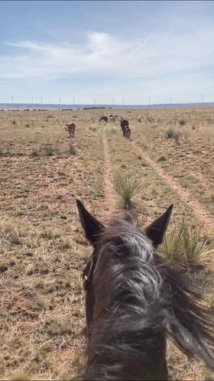
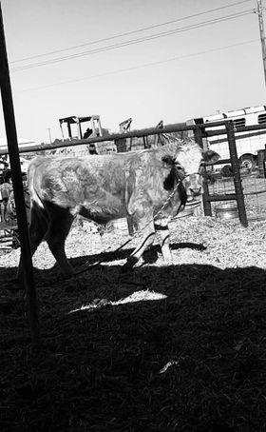
“Cowboyin”
Gavin S. Curry
“Cosmo”
Kyla F. Luna

Slide 8
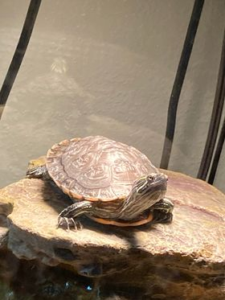
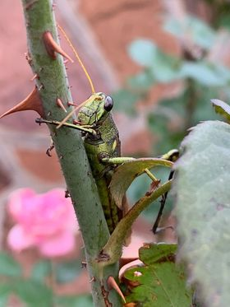
-First In Animals-
“Tank”
Logan S. Curry
“Hangin’ Out”
Nadya N. Dona Ana
1st

Slide 9
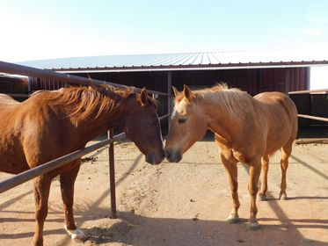
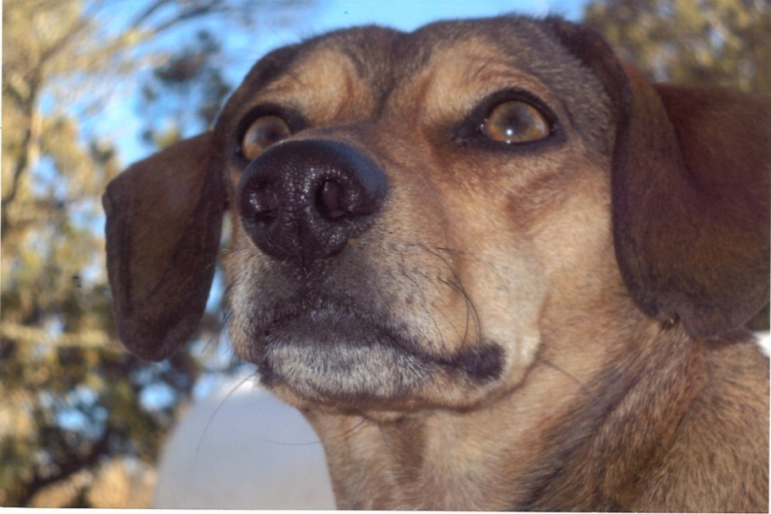
“Horse Love”
John T. Curry
“Day Dreamer”
Mindy G. Lincoln

Slide 10
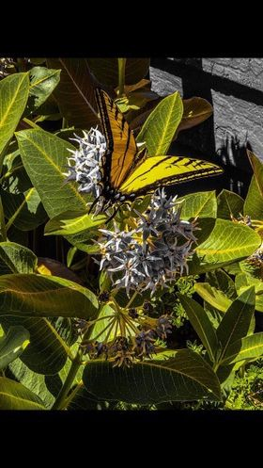
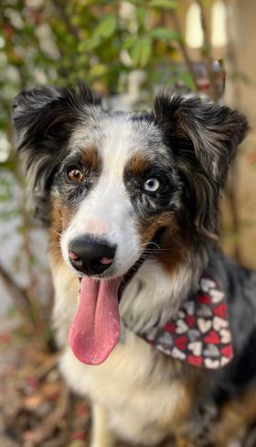
-Third In Animals-
“Peace Vibes”
Mia R. Guadalupe
“Ready to Round Up”
Jordan S. Dona Ana
3rd

Slide 11
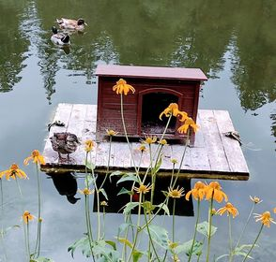
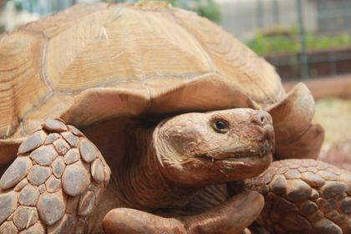
“Sulcata Tom's 85th Birthday”
Rilinger A. Otero
“Quacks”
Wesley O. Dona Ana

Slide 12
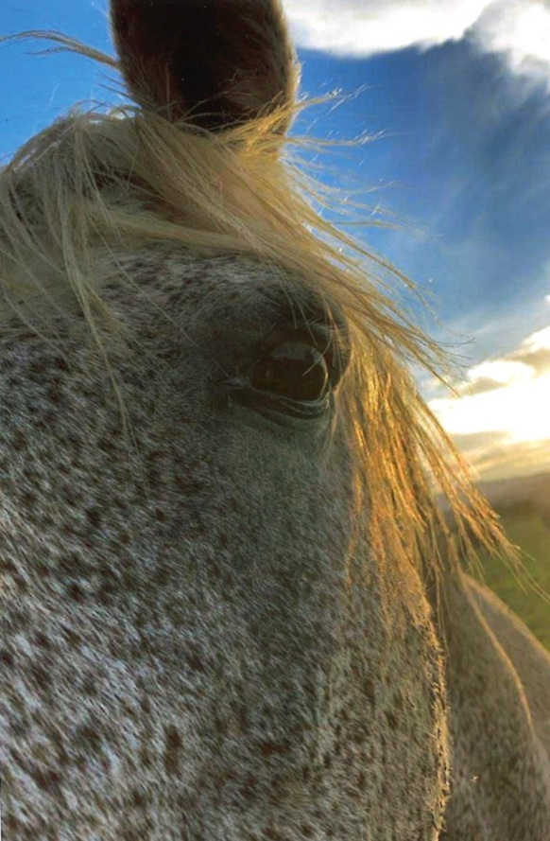
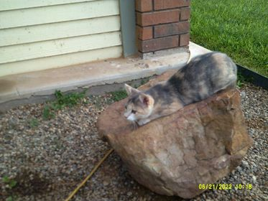
“Pouncing”
Elsie M. Roosevelt
“Horse”
Esperanza L. Socorro

Slide 13
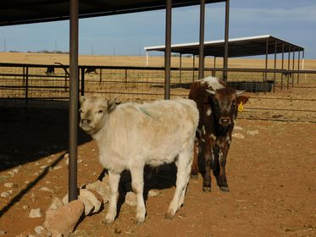
“The Oldest and The Youngest”
John T. Curry

Slide 14
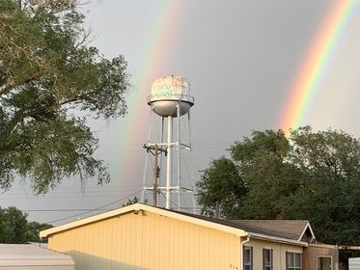
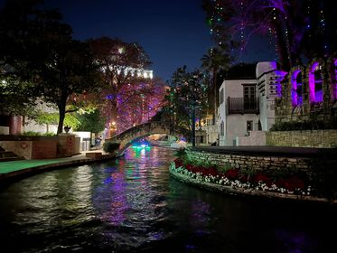
-Buildings-
-Third In Buildings-
“Rainbows Over Texico”
Denny T. Curry
“Christmas on the Riverwalk” MiKayla K. Quay
3rd

Slide 15
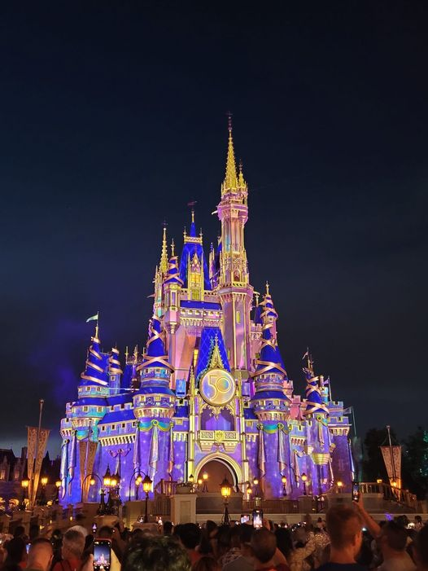
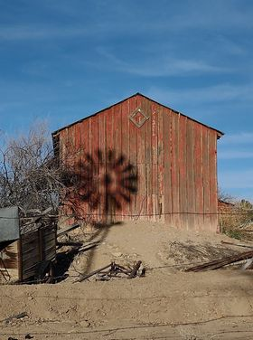
-First In Buildings-
-Second In Buildings-
“Magical”
Olivia G. Sandoval
“Windmill Shadow”
Wesley O. Dona Ana
1st
2nd

Slide 16
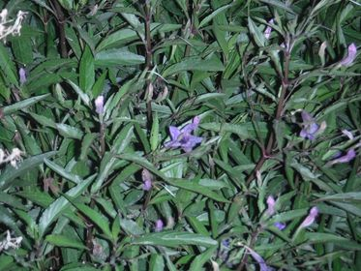
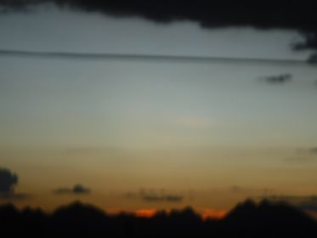
-Landscape-
“Purple at Night”
Ashley S. Dona Ana
“Fuzzy Sunset”
Austin S. Dona Ana

Slide 17
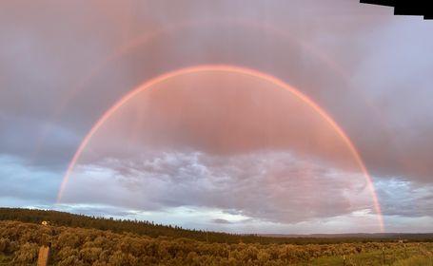
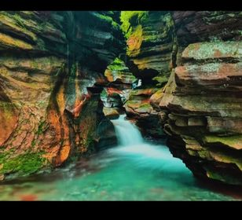
-Second In Landscape-
“Somewhere Over The Rainbow”
Ava G. Rio Arriba
“Beautiful Waterfall at Teton National Park”
Cadence B. San Juan
2nd

Slide 18
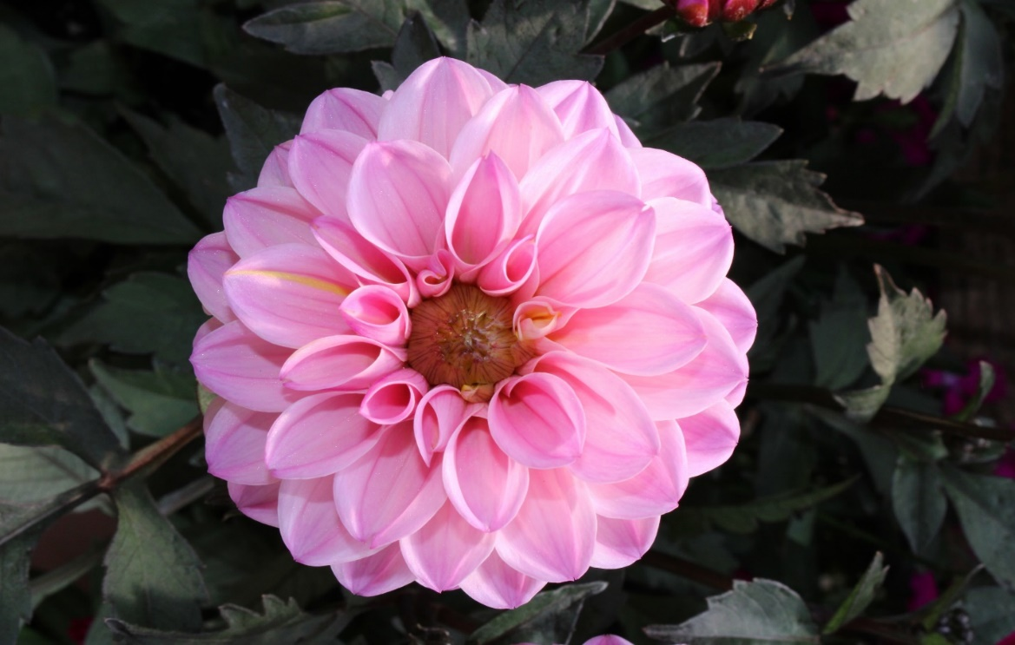
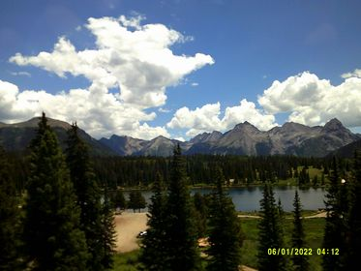
“Pretty in Pink”
ChristiAna T. Bernalillo
“Peaceful Lake”
Elsie M. Roosevelt

Slide 19
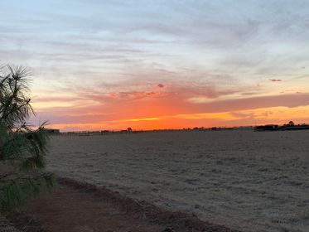
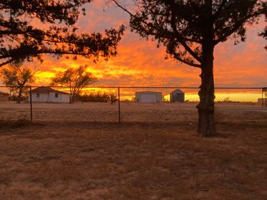
“Wide Open Spaces”
Gavin S. Curry
“Western Skies”
Gavin S. Curry

Slide 20
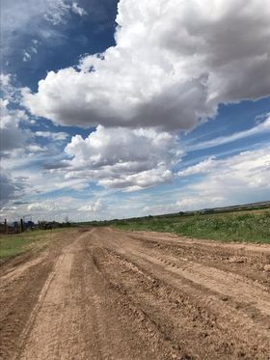
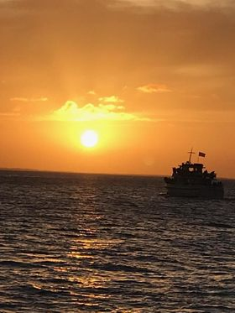
“Ol Dirt Road”
Janeah A. Socorro
“South Padre Sunset”
Janeah A. Socorro

Slide 21
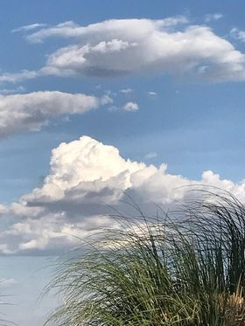
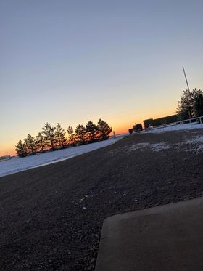
“Sunshiney Day”
Janeah A. Socorro
“Snowy Sunrise”
Logan S. Curry

Slide 22
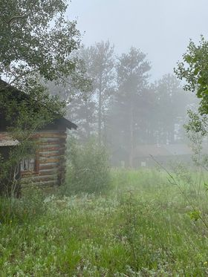
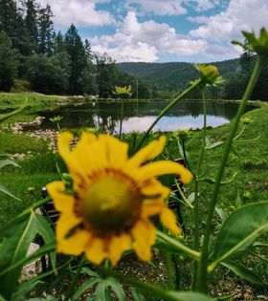
-Third In Landscape-
“Beyond”
Wesley O. Dona Ana
“Ponderosa Cabin”
Marisol R. Sandoval
3rd

Slide 23
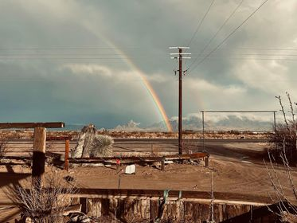
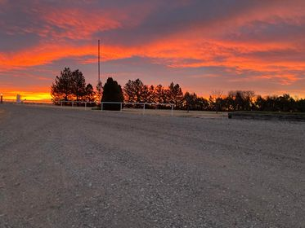
“Rain”
Kyla F. Luna
“Beauty in the sky”
Logan S. Curry

Slide 24
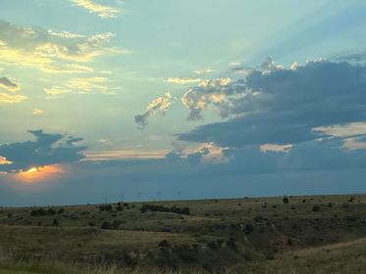
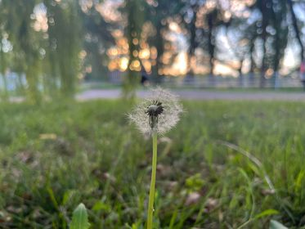
“Mesa Winds”
MiKayla K. Quay
“I See a Wish”
Payton M. Otero

Slide 25
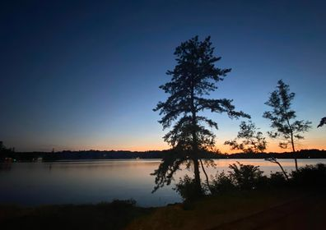
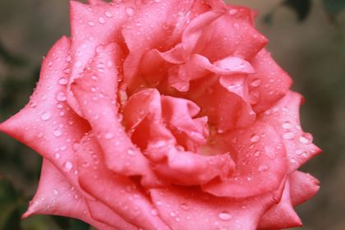
“New England Sunset”
Marisol R. Sandoval
“Rain on a Desert Rose”
Rilinger A. Otero

Slide 26
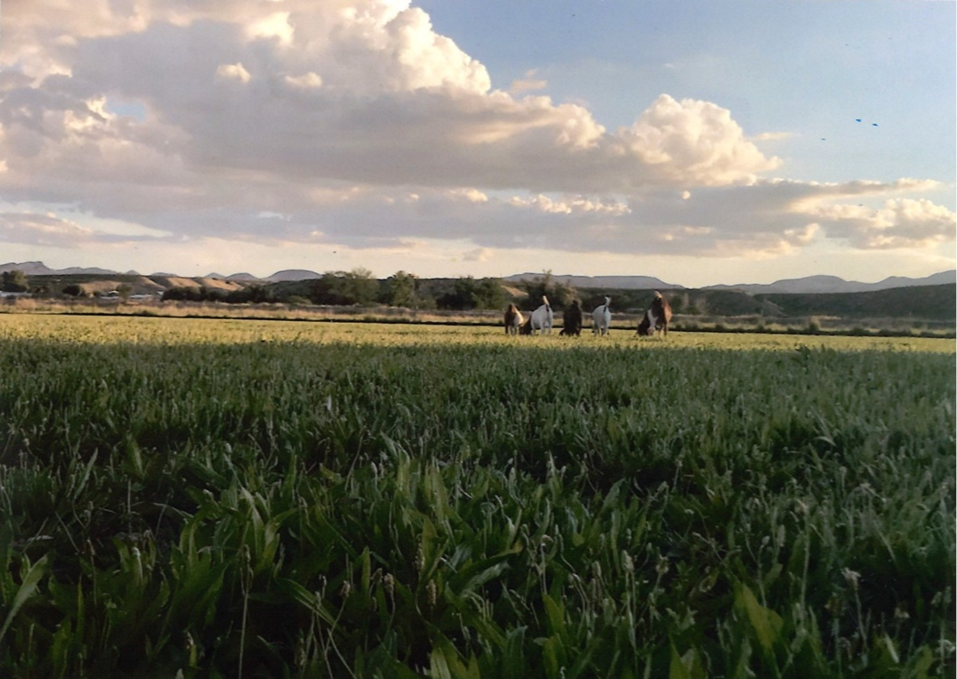
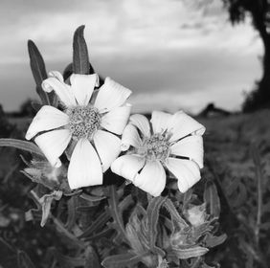
“Out To Pasture”
Maddie A. Socorro
“It’s the little things”
Mia R. Guadalupe

Slide 27
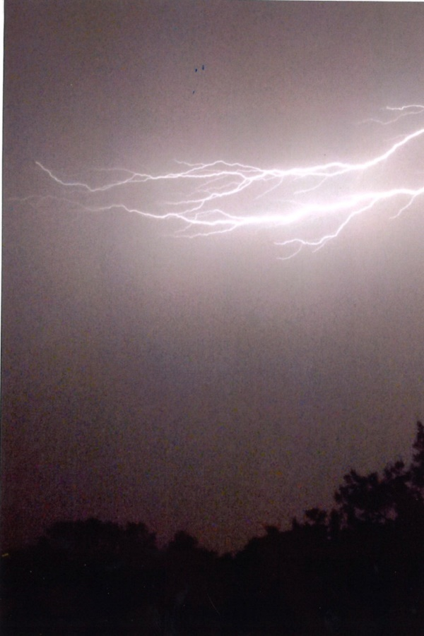
“God’s Fireworks”
Mindy G. Lincoln
“Mierra Tank”
Esperanza L. Socorro

Slide 28
“Safari”
Asapasia M. Torrance
“October Skies ”
Asapasia M. Torrance

Slide 29
-First In Landscape-
“Church Lights”
Payton M. Otero
“4 Hours of Winter”
Nadya N. Dona Ana
1st

Slide 30
“The Cloud of Stories”
Asapasia M. Torrance
“Gold Raindrops”
Payton M. Otero

Slide 31
-People-
-First In People-
“Orange Starburst”
Breanne L. Socorro
“Just Ranchin”
Ella H. Chaves
1st

Slide 32
“Hard Workers”
Destiny N. Socorro
“Love in the Air”
Elsie M. Roosevelt

Slide 33
-Third In People-
“Man’s Best Friend (Caiden and Chloe)”
ChristiAna T. Bernalillo
“Father Daughter time well spent”
Kyla F. Luna
3rd

Slide 34
“Off Into the Sunset”
John T. Curry
“Jet Blue Sky”
Kim B. Socorro

Slide 35
“Horses in the Heart”
Plummer B. Socorro
“Oh Brother”
Rilinger A. Otero

Slide 36
-Second In People-
“Puppy Love”
Faith M. San Juan
“What’s Up Doc”
Maddie A. Socorro
2nd

Slide 37
4-H
-First In 4-H-
“Shooting Sports”
Breanne L. Socorro
1st

Slide 38
-Second In 4-H-
-Third In 4-H-
“The Joy of 4-H”
Jordan S. Dona Ana
“Hard Work Pays Off”
Denny T. Curry
2nd
3rd

Slide 39
-Other-
-First In Other-
“Life On The Farm”
Denny T. Curry
“Water in the Desert”
Nadya N. Dona Ana
1st

Slide 40
“Official New Mexico Scenic Lizard”
Maddie A. Socorro

Slide 41
-Second In Other-
“Dragon” Marisol R. Sandoval
“The View is Plane Beautiful”
Jordan S. Dona Ana
2nd

Slide 42
-Third In Other-
“Kile Oak”
MiKayla K. Quay
“Tractor”
Esperanza L. Socorro
3rd

Slide 43
-Overall Winner-
“Hangin’ Out”
Nadya N. Dona Ana
Congratulations!

