Slide 1
Take 10 with 4-H:
District Contests
Open to Novice and Junior 4-H members
SOUTHEAST District – June 20-22, 2023 (Portales, NM)
SOUTHWEST District – June 20-21, 2023 (Catron county)
NORTHERN District – June 28-29, 2023 (Moriarty, NM)
District Contest Resources:
https://nm4h.nmsu.edu/policies/rules.html

Slide 2
4-H Contests are an extension of skills learned in 4-H projects.
BE BOLD. Shape the Future.®
New Mexico State University
Cooperative Extension Service
YOUTH LEARN TO:
Engage with peers.
Work as a team.
Practice public speaking skills and decision-making skills.
Have fun!
Family and Consumer Science Contests
Consumer Decision Making
Family & Consumer Science Skill-A-Thon
Family & Consumer Science Bowl
Fashion Revue
Favorite Foods
General Contests and Presentations
Parliamentary Procedure
Presentations - Agriculture, Family & Consumer Sciences, and General
Public Speaking – Impromptu
Public Speaking – Poetry
Public Speaking – Speech
Talent Show
Agriculture and Natural Resources Contests
Agronomy
Entomology
Hippology
Horticulture
Horse Bowl
Horse Judging
Livestock Judging
Livestock Skill-A-Thon
Meat Judging
Range Plant I.D.
Wildlife Habitat Evaluation
Shooting Sports Contests
Archery, Shotgun, Rifle, Pistol, Muzzle Loader, Hunting Skills

Slide 3
Family and Consumer Science Contests

Slide 4
Consumer Decision Making is…
A judging contest related to consumer products.
YOUTH LEARN TO:
Demonstrate their financial knowledge.
Think critically.
Practice decision-making skills.
Participants rank 4 classes with 4 items in each from best to worst based on a given scenario.
Toothpaste
Smoothies
Backpacks
Toys
Headphones
Give a set of oral reasons to tell why.
Novices give oral reasons on one class
Juniors give oral reasons on two class
Individual and team scores.
Fast Food
Shoes
Sunglasses
Tablets
Jeans

Slide 5
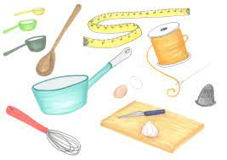
Family & Consumer Science Skill-a-thon is…
Identification of kitchen, sewing,
and interior design items.
YOUTH LEARN TO:
Demonstrate their knowledge.
Use critical thinking skills for money management
Practice consumer decision making skills.
Identification for Novice and Juniors:
Food & Nutrition – 25 items
Sewing & Clothing – 25 items
Interior Design & Housing – 15 items
Judging Section
Place a class of 4 food items from best to worst.
Individual and team scores.
Family & Consumer Science Bowl
(SE District)
Teams of 3 or 4 participants answer toss up questions with a buzzer system.
Individual and team scores.

Slide 6
Fashion Revue is…
Modeling of a sewing exhibit and an oral presentation.
Youth learn to:
Demonstrate their knowledge about sewing.
Be organized and manage their time.
Practice speaking skills.
Participants must be enrolled in a Sewing project
Sew Much Fun I & II
Mix & Match I & II
Sew ‘N Go
Serger Sewing
Creative Touches
Senior Clothing Construction I & II
Quilting
Fashion Magic I, II, III, and IV

Slide 7
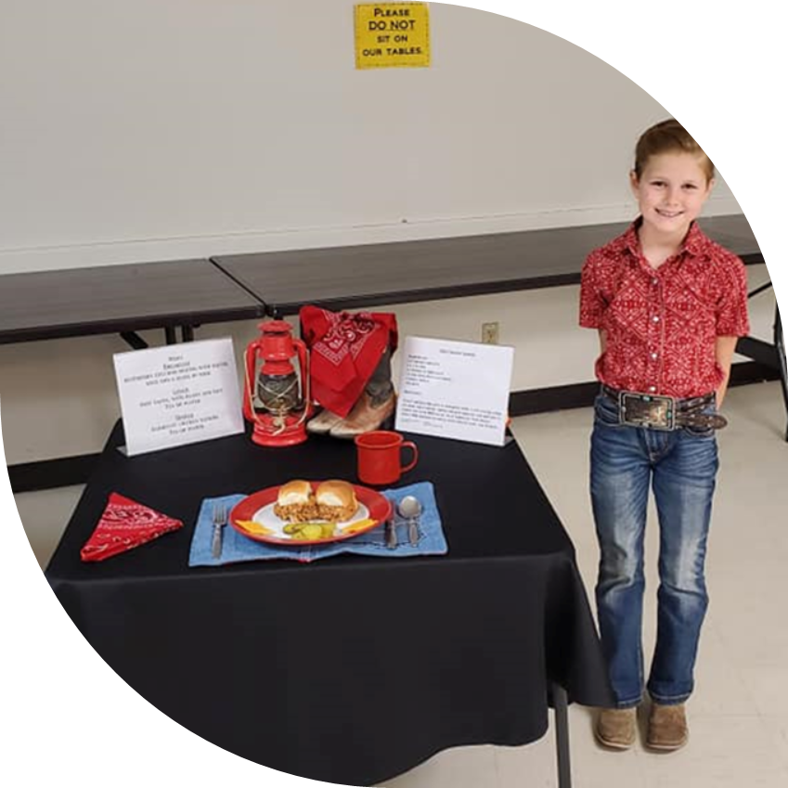
Favorite Foods is…
Preparing a dish, setting a table, and an interview.
YOUTH LEARN TO:
Demonstrate their knowledge about nutrition.
Prepare healthy food in the kitchen.
Work within the allotted time.
Practice speaking skills.
Participants may prepare:
Main dish
Salad
Sandwich
Bread
Fruit or vegetable dish
Healthy Snack

Slide 8
General Contests

Slide 9
Presentation Contest is…
A prepared demonstration or illustrated talk.
YOUTH LEARN:
To demonstrate their knowledge about a particular topic.
Public speaking skills.
Planning & organizing skills.
Self-confidence.
Time Limits:
Novice: under 5 minutes
Junior: under 10 minutes
Participant may use visuals.
Agriculture
Animal Science, Horticulture, Agronomy, and Natural Science projects.
Family & Consumer Sciences
Clothing, Foods, Housing & Interior Design, Consumer Education & Family Life projects.
General
Engineering, Personal Growth & Development, Creative Arts and Arts & Crafts projects.

Slide 10
Public Speaking: Impropmtu Contest is…
A speaking competition on an unknown topic.
YOUTH LEARN:
Critical thinking skills.
Public speaking skills.
Planning and organizing skills.
Self-confidence.
Participants will:
Draw 3 topics and choose one to speak on.
Be given 3 minutes to organize their thoughts.
Give a 3 – 5 minute speech.
No visual aides may be used.

Slide 11
Public Speaking: Poetry Contest is…
A speaking competition on an unknown topic.
YOUTH LEARN:
Self-confidence.
Public speaking skills.
Time management.
Teamwork.
Parliamentary Procedure (SE District)
Teams of (6) members (Novice or Junior) demonstrate a meeting protocol.
Team scores only.
Participants recite a memorized poem.
Can be original or from book.
Novice = 1 – 2 minutes
Junior = 2 – 4 minutes
Individual scores only.

Slide 12
Public Speaking: Prepared Speech Contest is…
A speaking competition on a prepared topic.
YOUTH LEARN:
Planning and organizing skills.
Public speaking skills.
Self-confidence.
Participants will:
Develop and practice a speech on a chosen topic
Deliver a prepared speech from memory
Speech types:
Informational
Persuasive
Inspirational
Entertaining
Time limit:
Novice = 2 – 4 minutes
Junior = 4 – 6 minutes

Slide 13
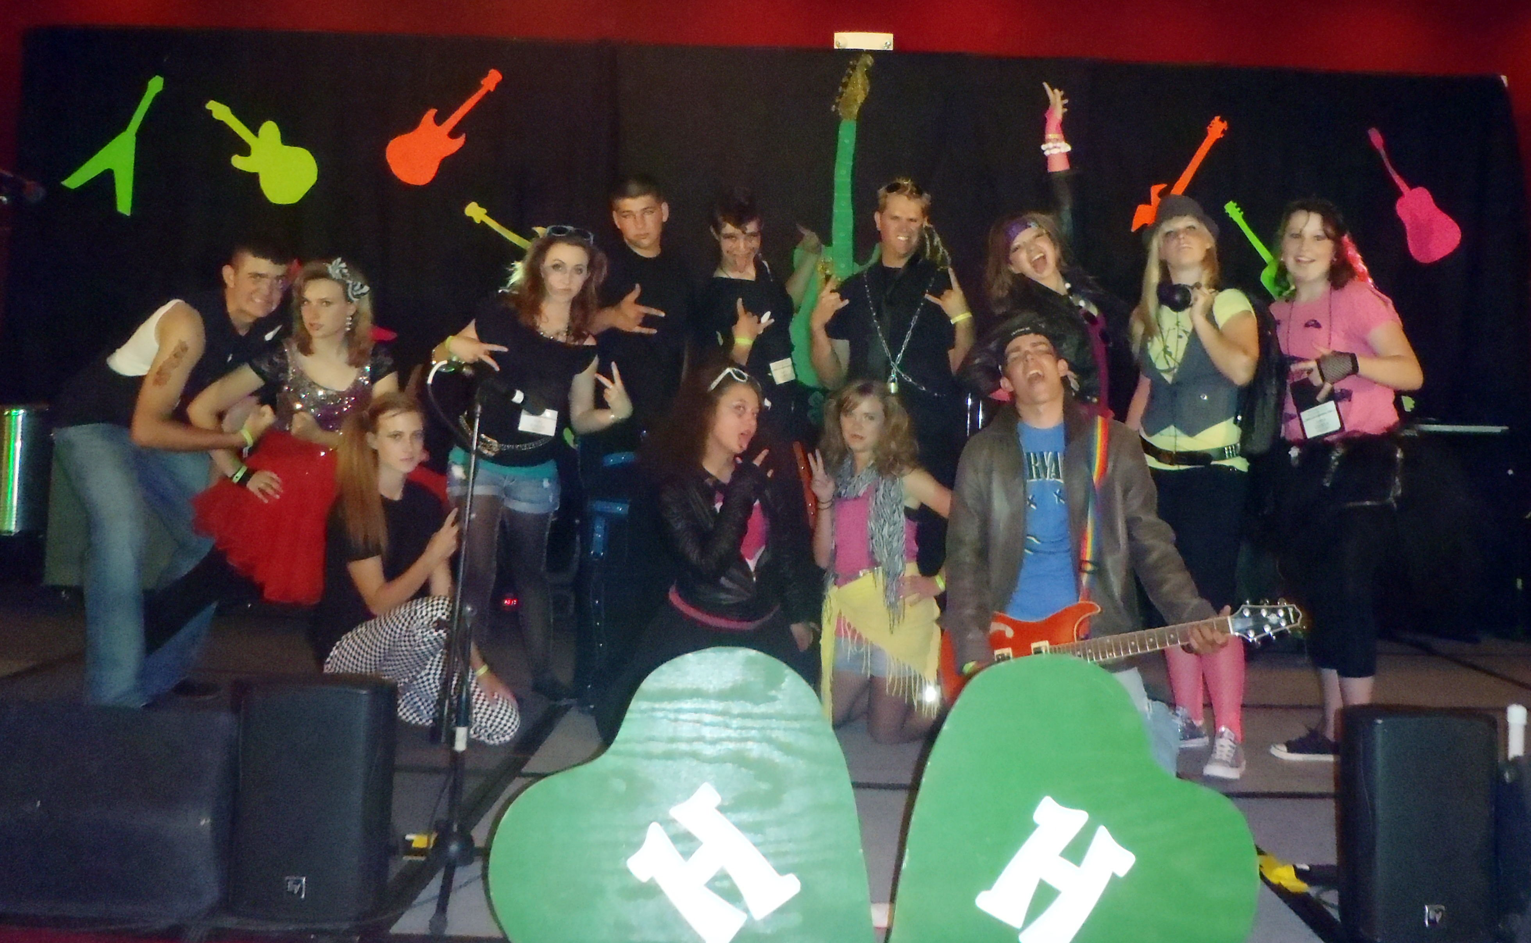
Talent Contest is…
An opportunity to develop self-confidence through special skills and public appearance.
YOUTH LEARN:
Planning and organizing skills.
Self-responsibility.
Self-confidence.
Categories:
Comedian
Vocal
Musical
Choreographed Routines
Drama
Celebrate 4-H Categories
6-minute time limit.
Individual or group (up to 5).

Slide 14
Agriculture Contests

Slide 15
Agronomy is…
Identification of components related to soil management and crop production.
YOUTH LEARN:
Critical thinking skills.
Decision making skill.
Planning and organizing.
Novice and Juniors will identify:
20 plants
20 seeds
8 kinds of farm equipment
5 insects and their characteristics
Place (3) classes of 4 related items based on quality, uniformity, and shelf life.
Juniors will answer (5) seed tag questions
Point of origin
Harvest date
Germination rate
Indicate if noxious weed
Individual and team scores.
The Agronomy contes
is offered in the
SE and SW districts.

Slide 16
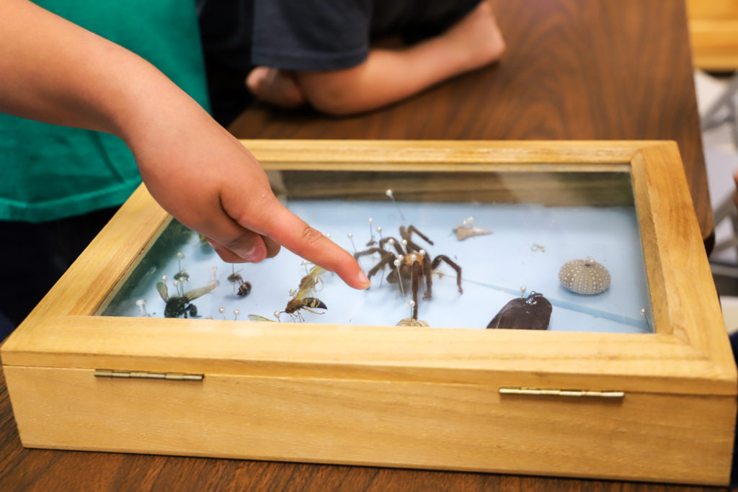
Entomology is…
Insect identification and their mouth parts.
YOUTH LEARN TO:
Demonstrate their knowledge about insects.
Use critical thinking skills.
Work within the allotted time.
Novice members
Identify 25 specimens from a master list provided.
100 points possible.
Twenty-five minutes allotted time.
Junior members
Identify 25 specimens from a master list provided.
Identify the type of mouthparts
Total of 150 points possible.
Twenty-five minutes allotted for each section.
Individual and team scores.

Slide 17
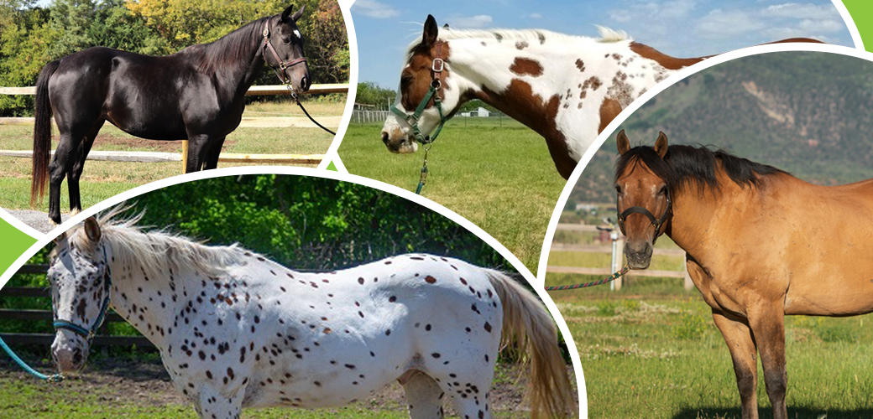
Hippology is…
An interactive contest about all things pertaining to horses.
YOUTH LEARN TO:
Demonstrate their knowledge.
Use critical thinking skills.
Work as a team.
Contest has 2 parts (1 hours each): 200 points each
Written exam on breeds, colors, and anatomy.
Station Phase – identify horse related item like saddles, tack, tools, equipment, and feeds.
Individual scores only.

Slide 18
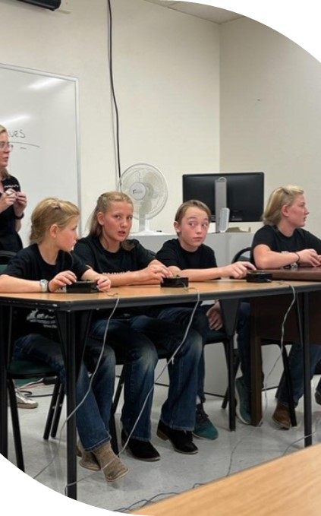
Horse Bowl is…
A quiz game about all things pertaining to horses.
YOUTH LEARN TO:
Demonstrate their knowledge about horses
Use critical thinking skills.
Work as a team.
Teams of 3 or 4 members answer a total of 40 questions using a buzzer system:
Individual – designated for a particular member (chair).
Toss up – anyone from either team may answer.
Bonus – team can discuss and designate one member to answer.
Individual and team scores.

Slide 19
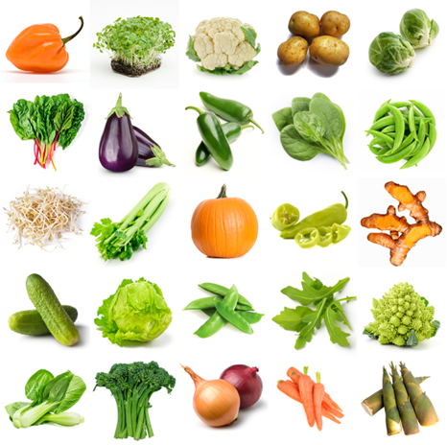
Horticulture is…
Identification of plants, fruits, and flowers.
YOUTH LEARN TO:
Demonstrate their knowledge about horticulture.
Use critical thinking skills.
Work within the allotted time.
Novice and Junior participants complete 2 parts:
Identify 40 specimens of vegetables, fruits, house plants, flowers, and nursery plants from master list provided
Place 2 classes horticulture products based on their quality and characteristics from best to worst.
Individual and team scores.

Slide 20
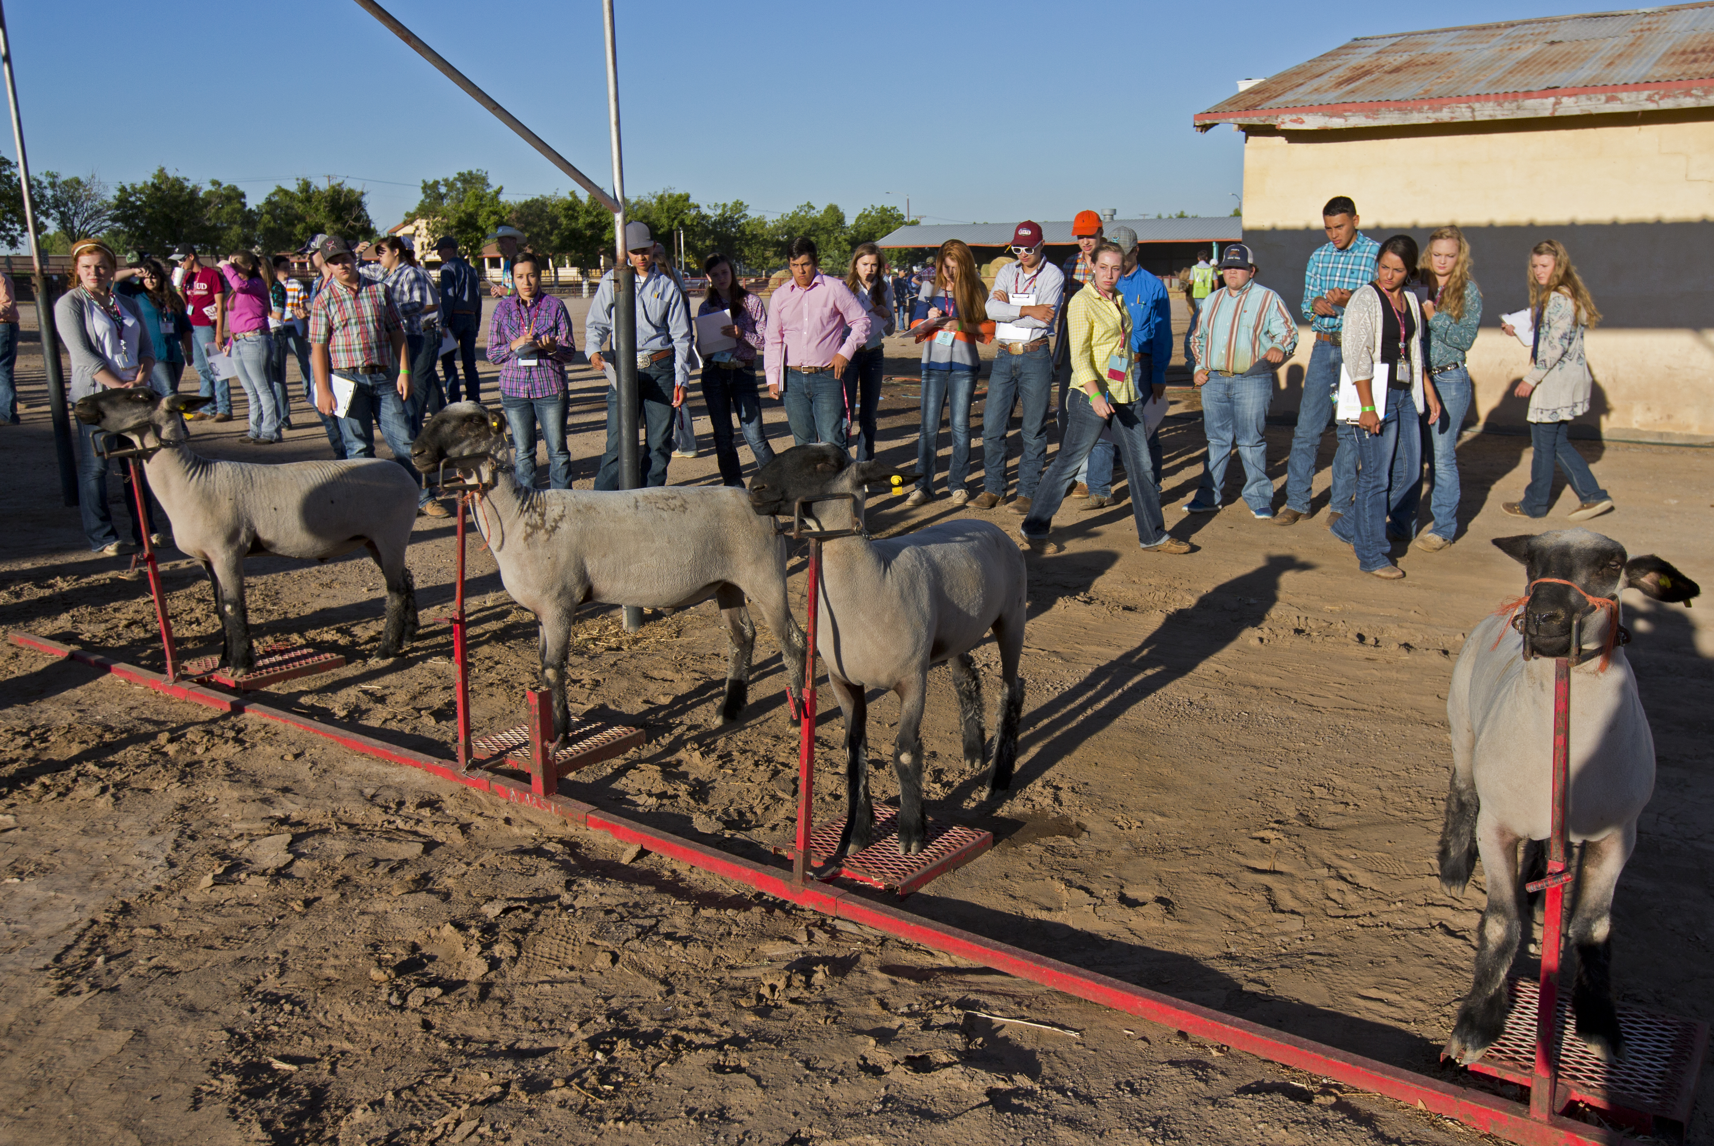
Livestock Judging is…
The evaluation and placement of a group of animals.
YOUTH LEARN TO:
Demonstrate their knowledge.
Practice decision making skills.
Use critical thinking skills.
Practice speaking skills.
Novice and Junior Participants place 4 classes of 4 animals from best to worst. (Cattle, Sheep, Goats, Pigs)
15 minutes allotted for each class.
Animals may be intended for market or breeding.
Novice members give oral reasons on 1 class.
Junior members give of oral reasons on 2 classes.
Individual and team scores.

Slide 21
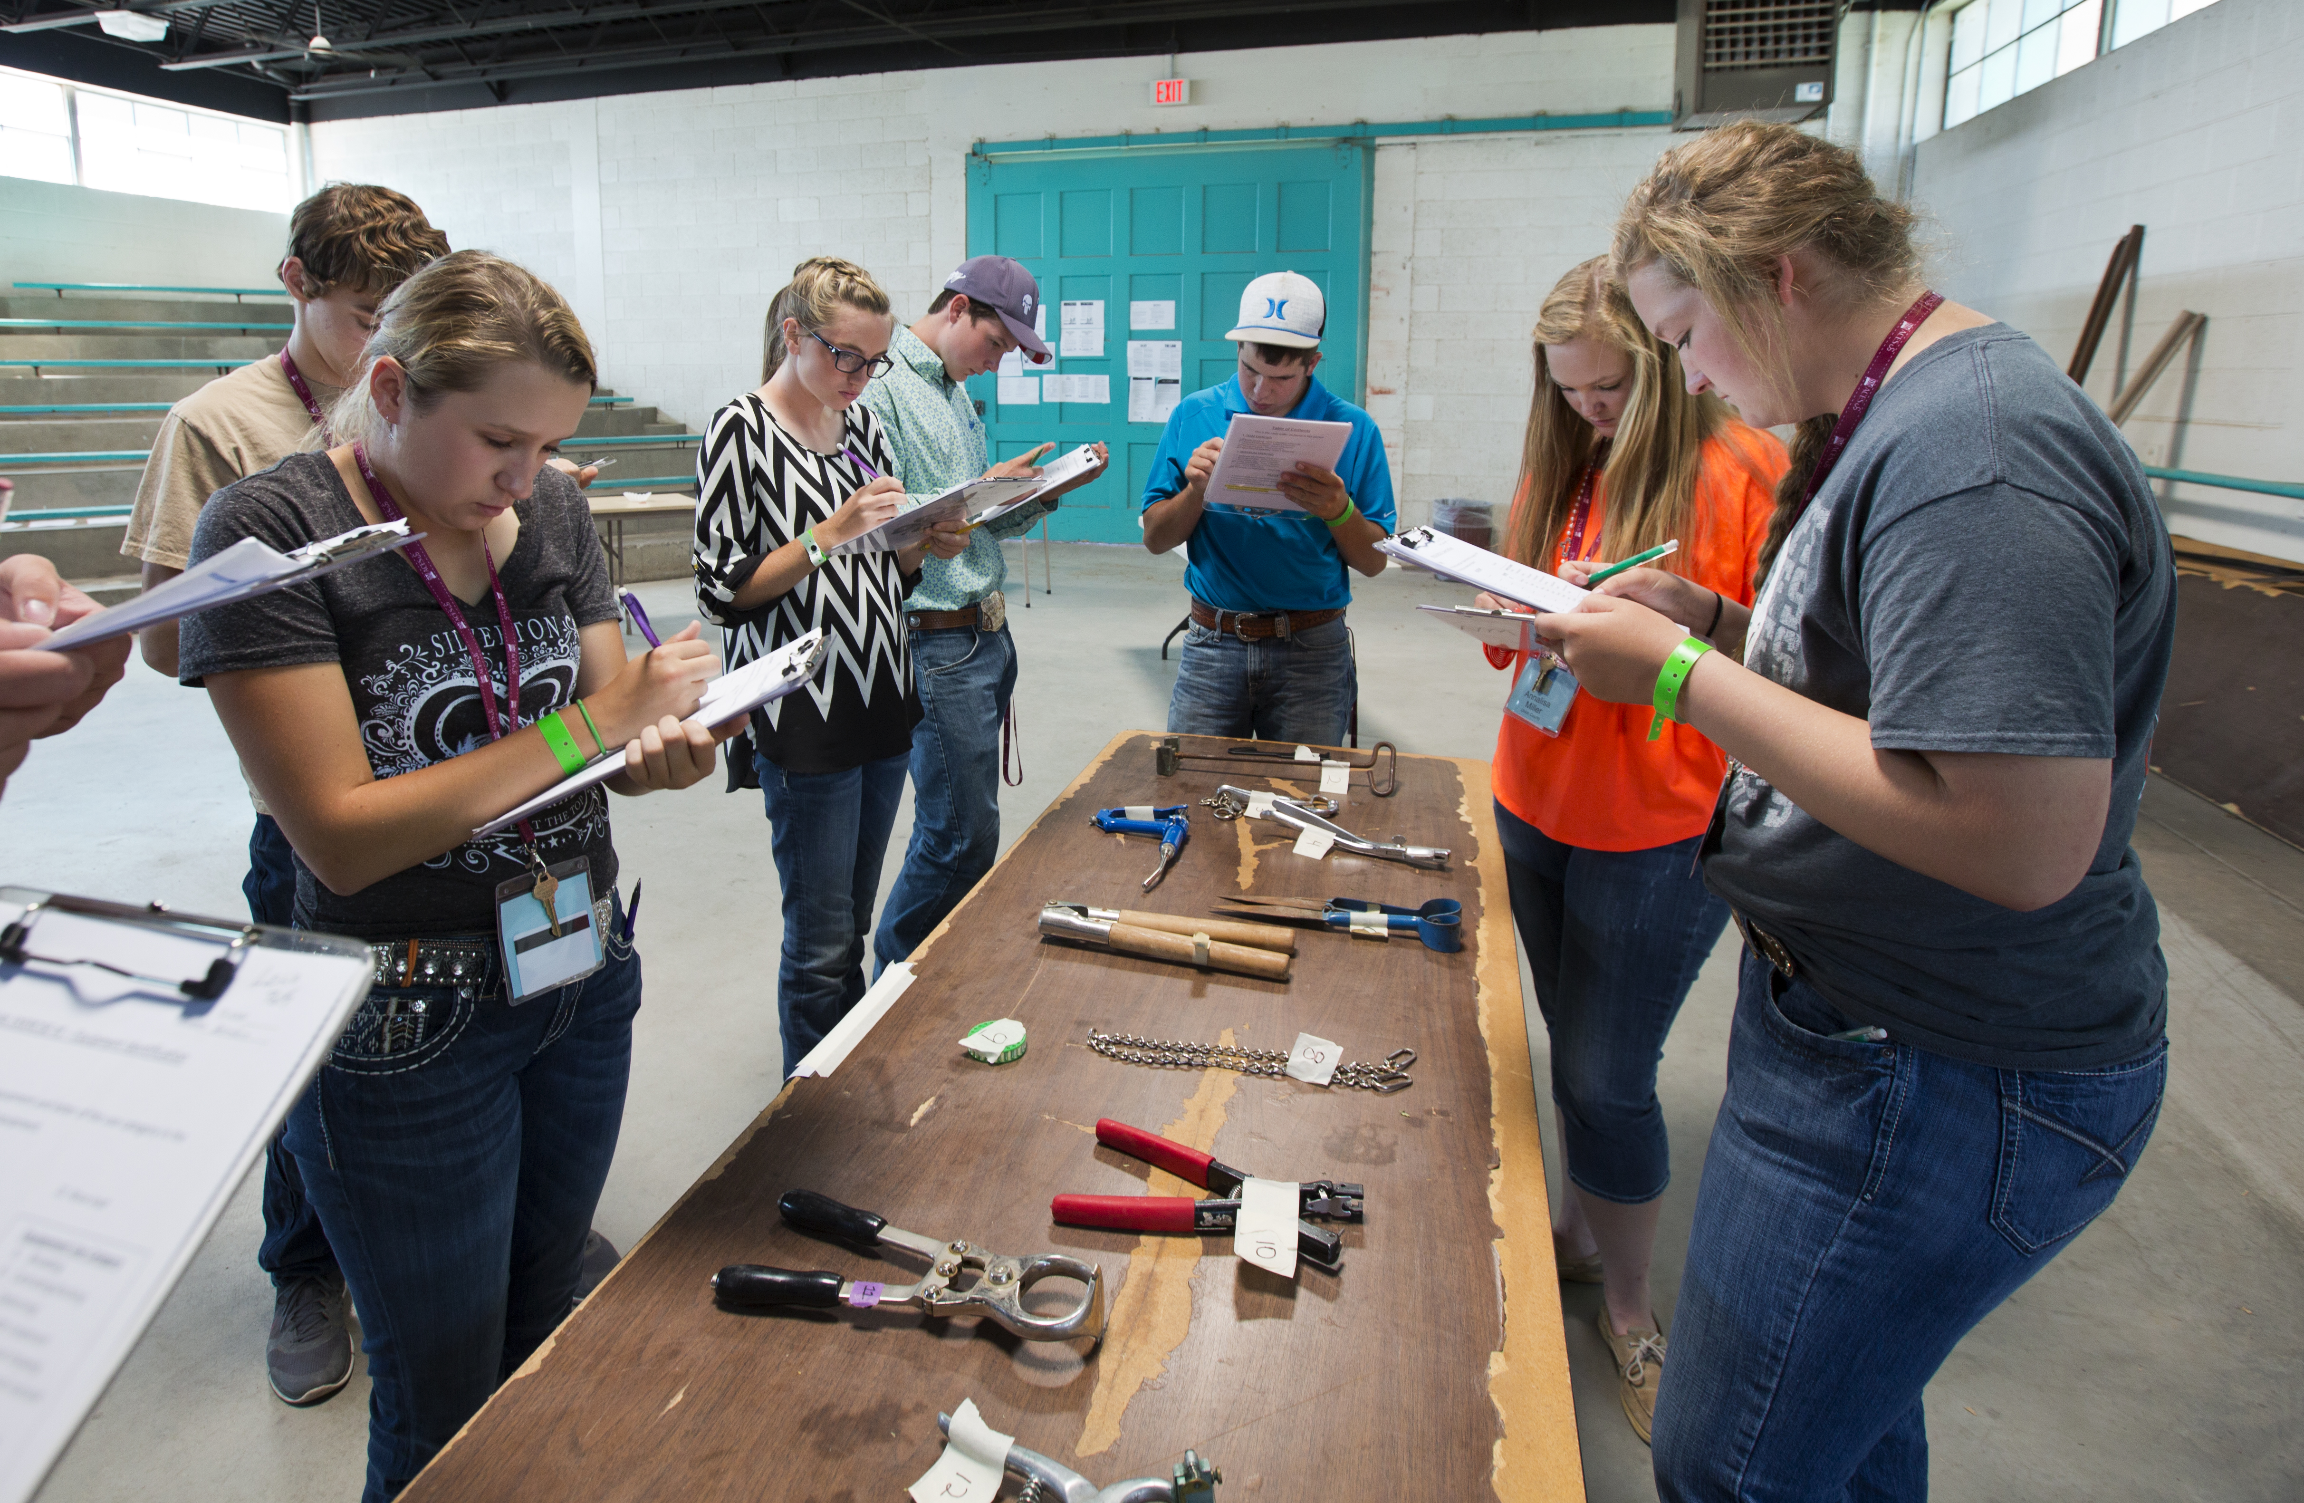
Livestock Skill-a-thon is…
Identification and practicum contest related to livestock production.
YOUTH LEARN TO:
Demonstrate their knowledge about livestock .
Practice decision making skills.
Use critical thinking skills.
Novice and Junior Identify and evaluate:
Breeds of livestock
Types of feeds
Equipment
Read feed tags
Medicine labels
Identify cuts of meats
Judge a class of meat

Slide 22
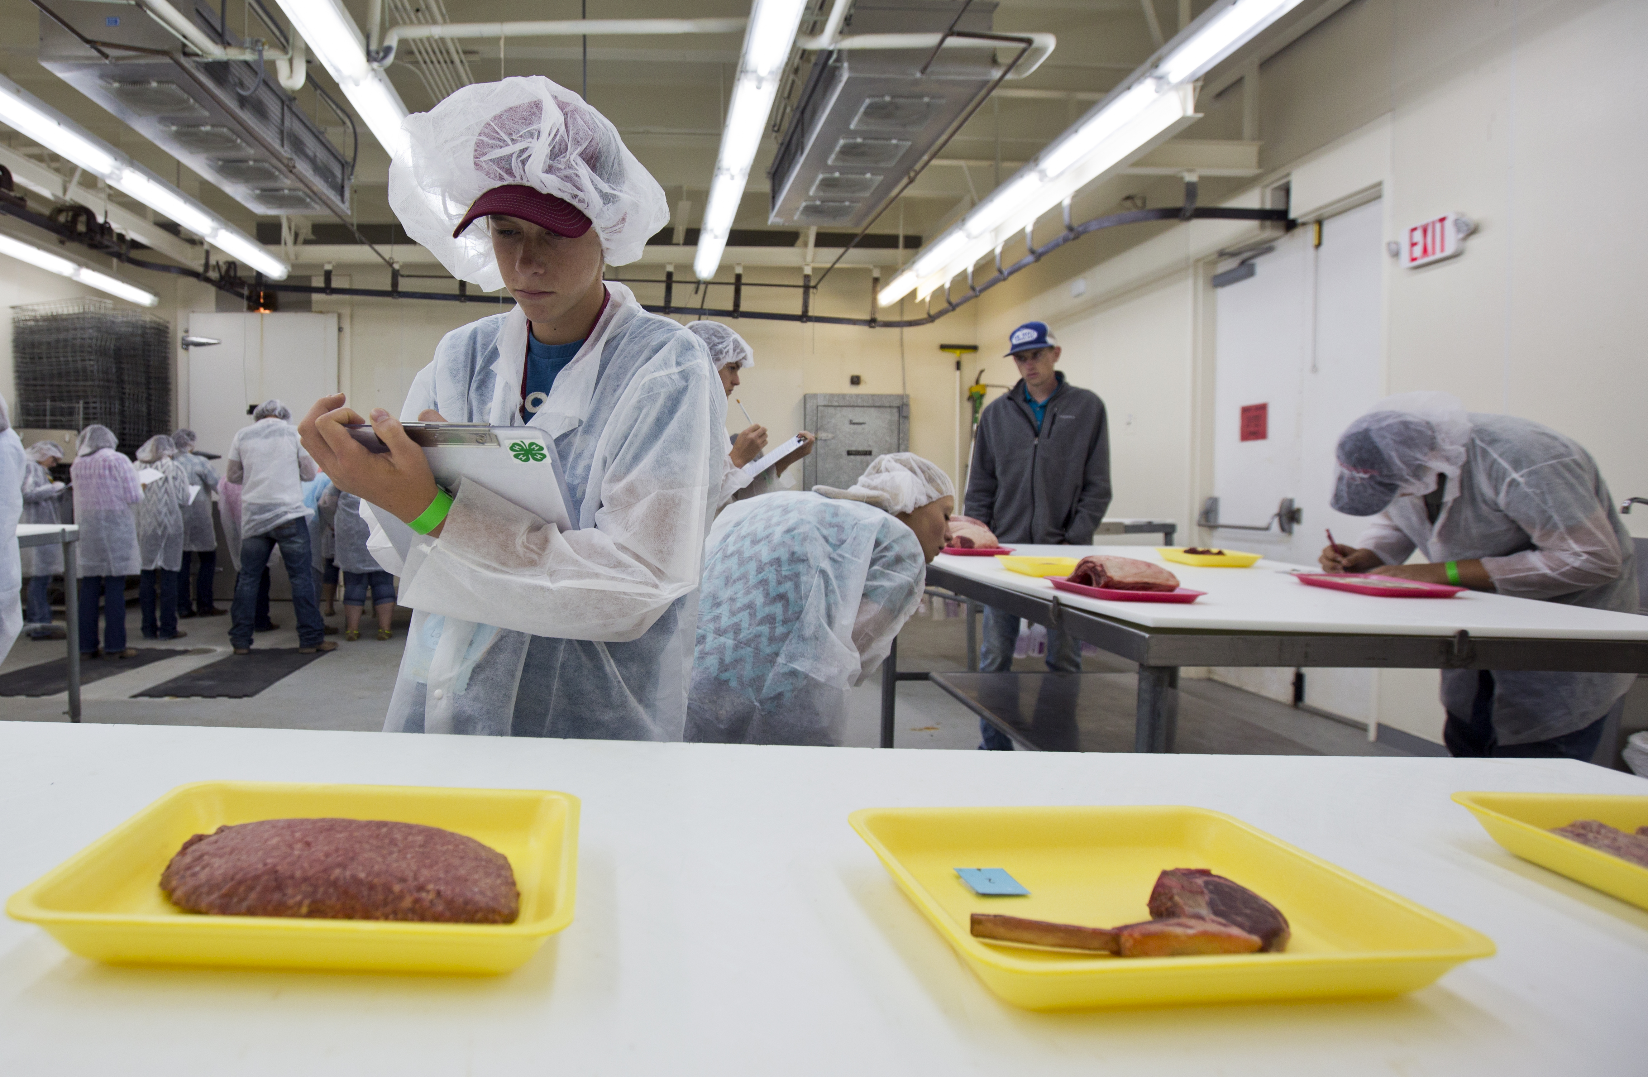
Meats Judging is…
Evaluation of cuts of meat.
YOUTH LEARN TO:
Demonstrate their knowledge about meats.
Practice decision making skills.
Use critical thinking skills.
Identify 15 retail cuts – beef, pork, and lamb.
Name of species
Name of primal cut
Name of retail cut
Place a class of meats from best to worst based on a set of criteria.
Individual and team scores.

Slide 23
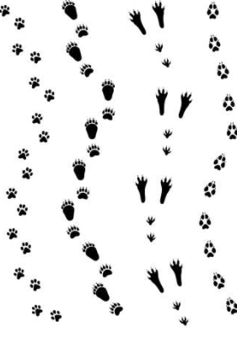
Wildlife Habitat Contest is…
An identification and general knowledge contest about wildlife species, ecoregions, population management.
YOUTH LEARN:
Critical thinking skills.
Problem solving skills.
Decision making skills.
Novice and Junior members will:
Identify 25 wildlife species
Answer 25 General Knowledge questions
Individual and team scores.

Slide 24
Thank you!
More information can be found at:
https://nm4h.nmsu.edu/

