Slide 1
Take 10 with 4-H
State 4-H Conference
Courtney Mitchell
Harding County
Brittany Sonntag
Bernalillo County

Slide 2
What is State Conference?
Senior 4H Event
Participate in Competitions
Engage in Leadership Development
On the NMSU Campus
Stay in the dorms
Eat in Cafeteria
In Las Cruces, NM
Fun!
Second week in July

Slide 3
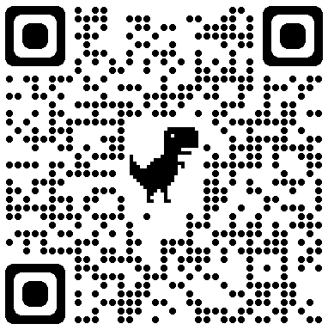
What Contests are Available?
Ag and Natural Resources
Agronomy
Entomology
Hippology
Horticulture
Horse Bowl
Horse Judging
Livestock Judging
Livestock Skill-a-thon
Meat Judging
Range Management
Wildlife Habitat Evaluation
Family and Consumer Science
Consumer Decision Making
FCS Bowl
FCS Skill-a-thon
Fashion Review
Favorite Foods
Other
Presentations: -Ag -FCS -General
Public speaking: -Impromptu -Prepared
Talent Show
https://nm4h.nmsu.edu/4h/conference.html

Slide 4
What do youth do when not in a contest?
Engaging Workshops
Nightly Dances
Community Service Project
Amazing Guest Speakers
Election of State Officers

Slide 5
100th Year of State Conference!
Special celebration for the 100th year of state conference
Special recognition of previous state leadership team members

