Slide 1
New Mexico 4-H 101
Part 1

Slide 2
Welcome to New Mexico 4-H
Let’s look at the big picture of New Mexico 4-H, whose program it is, who is administratively responsible for 4-H in New Mexico and how you and your family can be a part of New Mexico 4-H program.
But first we need to see who administers this program and how it is connected to New Mexico State University.

Slide 3
Research
Teaching
Service
Under the Morrill Act of 1862, New Mexico College of Agriculture and Mechanical Arts was designated as the state’s land-grant institution and today is known as New Mexico State University. New Mexico State University is dedicated to teaching, research, and service.

Slide 4
There are over 100 Land Grant Universities in the country.

Slide 5
In 1914 the Smith-Lever Act passed which created the Cooperative Extension Service. This Act conveys knowledge from the NMSU College of Agricultural, Consumer and Environmental Sciences to the people and needs of the people to the NMSU College of Agricultural, Consumer, and Environmental Sciences. The Cooperative Extension Service does this through its many programs offered by the county/tribal extension agent in every New Mexico county.
Service

Slide 6
NMSU
NMSU College of Agricultural, Consumer and Environmental Services (ACES)
New Mexico Cooperative Extension Services (CES)
4-H
District CES Director
County Extension Office

Slide 7
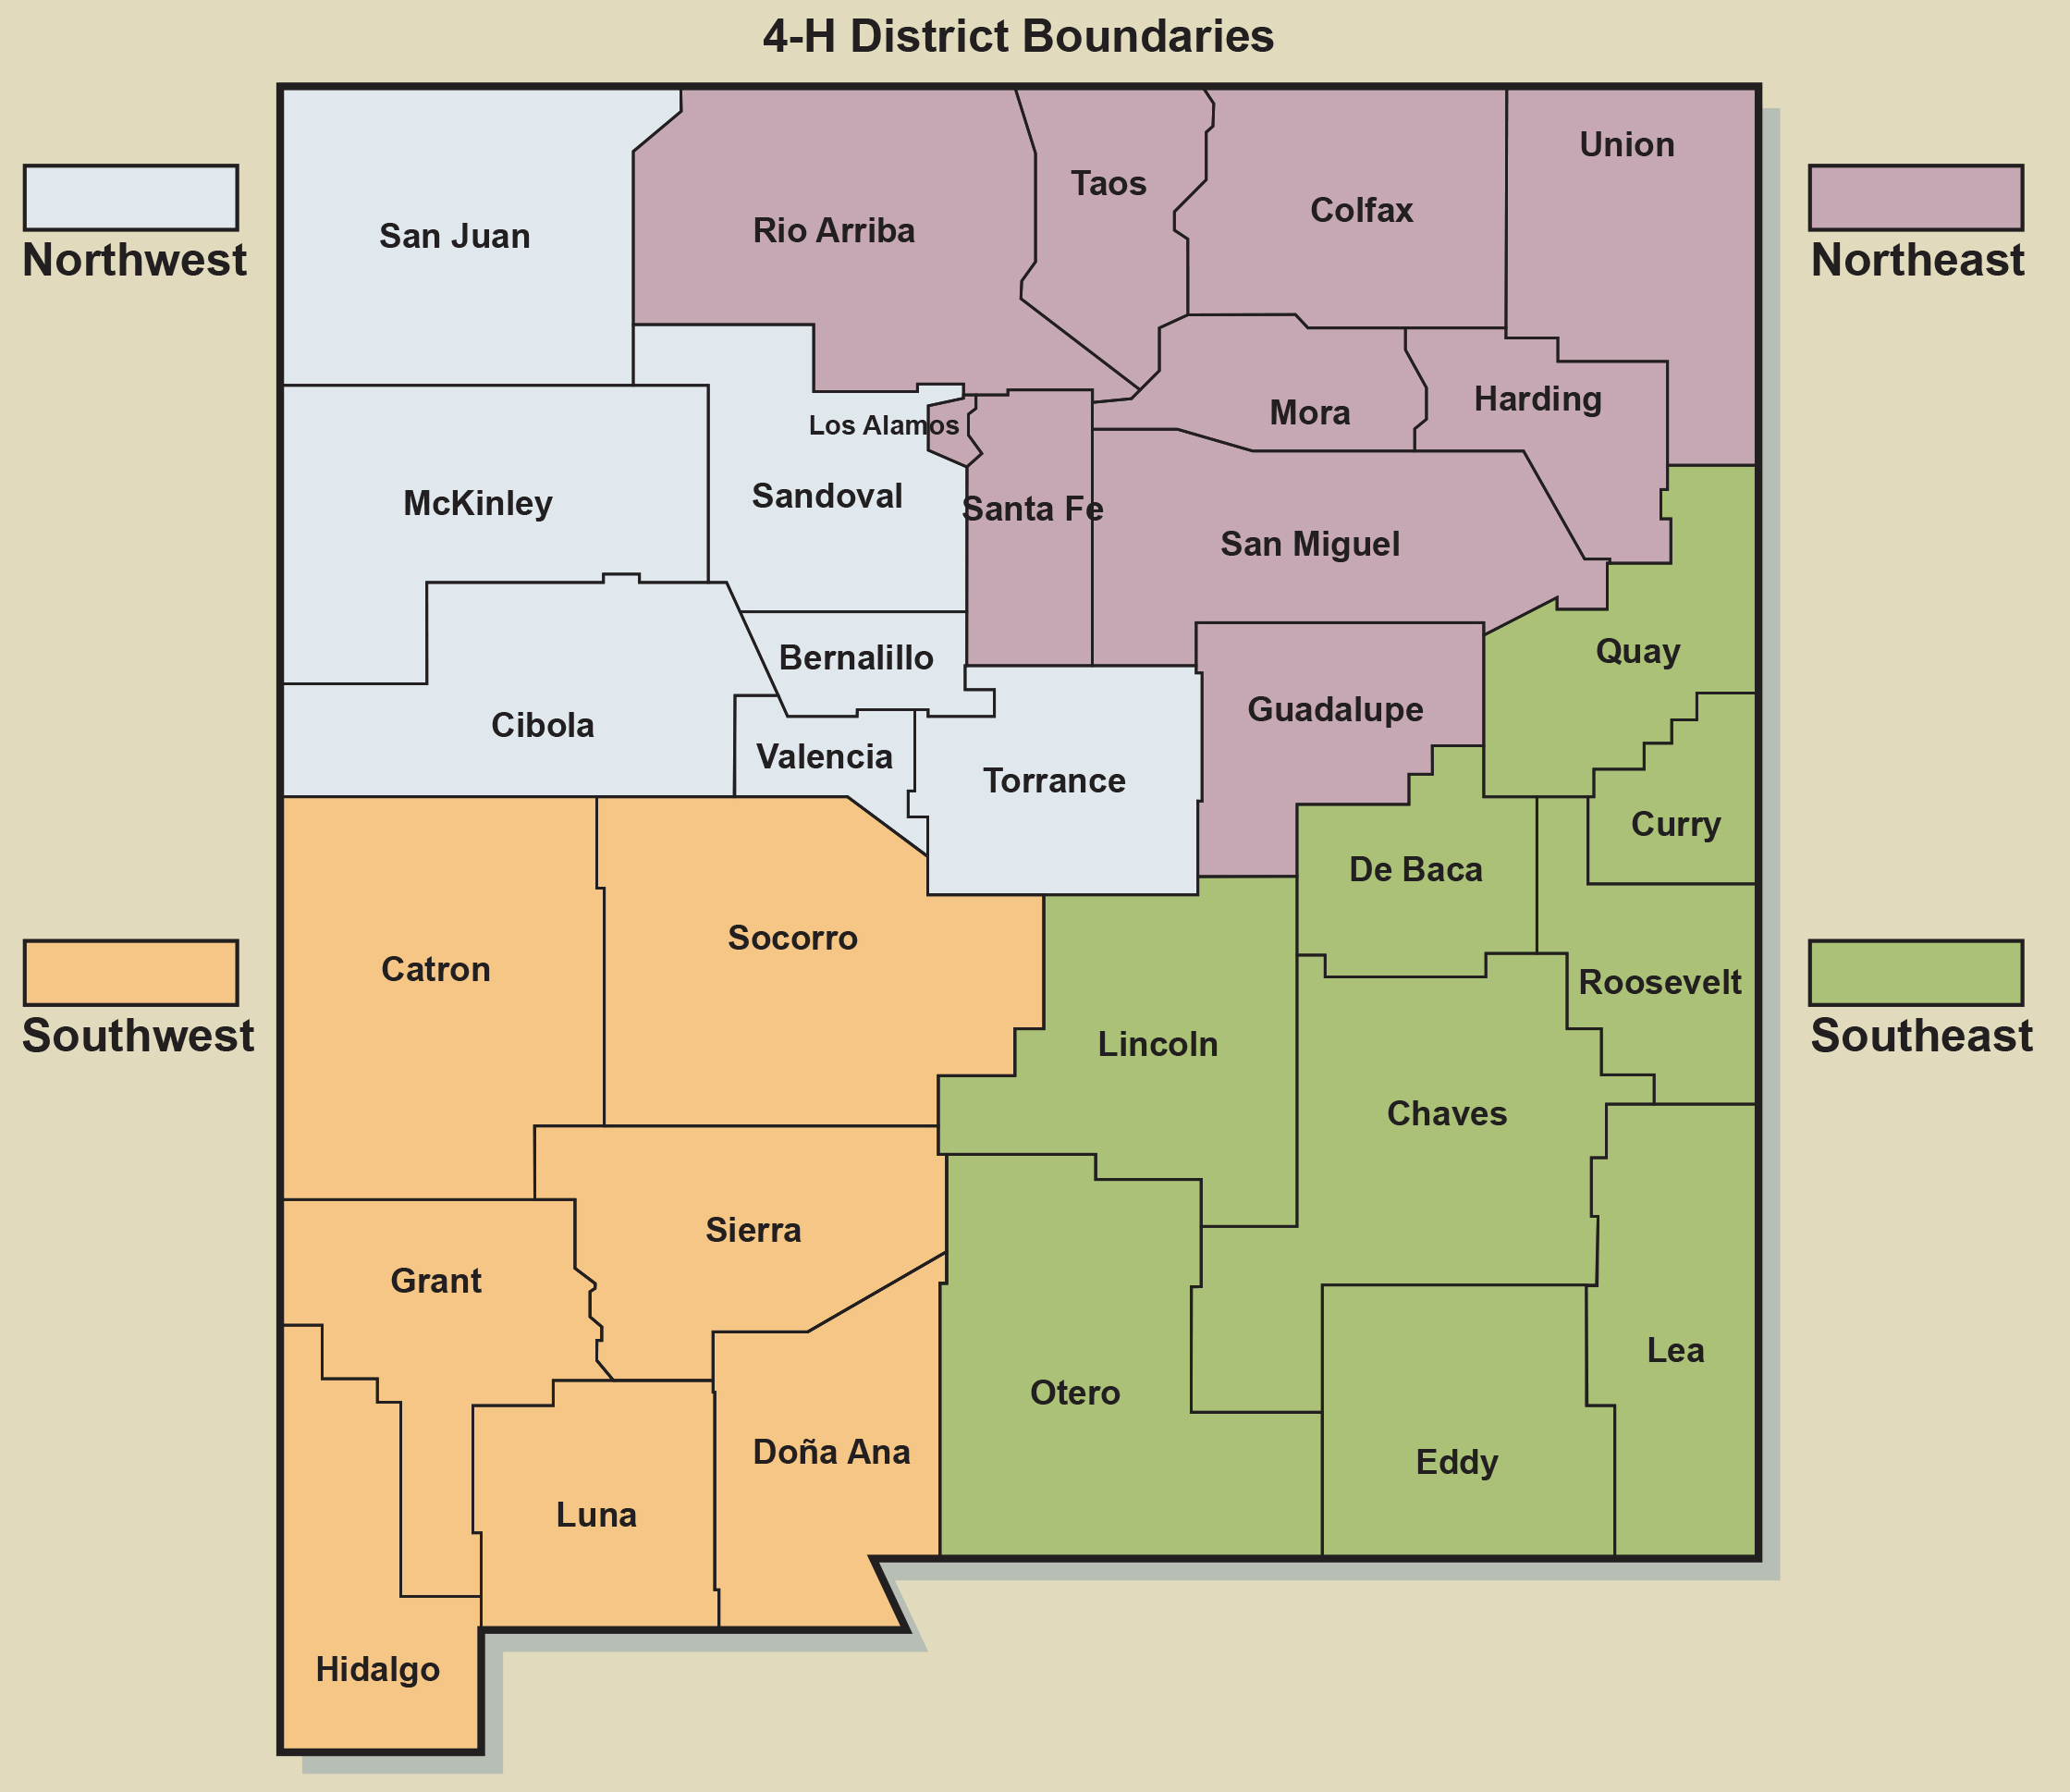
New Mexico has an office in every county
Bernalillo Catron Chaves Cibola Colfax Curry De Baca Doña Ana Eddy Grant Guadalupe Harding Hidalgo Lea Lincoln Los Alamos Luna | McKinley Mora Otero Quay Rio Arriba Roosevelt San Juan San Miguel Sandoval Santa Fe Sierra Socorro Taos Torrance Union Valencia
Notes:
4-H Districts

Slide 8
The Cooperative Extension Service provides the people of New Mexico, and the greater USA, with practical, research-based knowledge and programs to improve their quality of life.
New Mexico Cooperative Extension Service offices are found in all 33 counties, and are a part of the NMSU College of Agricultural, Consumer, and Environmental Sciences.

Slide 9
County Extension Office
County Program Director
County Extension Agent
Programs
4-H
Ag
FCS
Others
Program areas include 4-H Youth Development, Agriculture and Natural Resources, Family and Consumer Sciences and many other programs to improve the quality of life.

Slide 10
4-H is the youth development program of the Cooperative Extension Service.
It is the largest youth organization in the world.

Slide 11
Research-based
Youth education program
Based on the four concepts of positive youth development
Concepts of Youth Development
Belonging
Independence
Generosity and
Mastery
4-H is

Slide 12
Belonging
Positive Relationship with a caring adult
An Inclusive environment
A safe environment
Mastery
Engagement in Learning
Opportunity for Mastery
Independence
Opportunity to see oneself as an active participant in the future
Opportunity for self determination
Generosity
Opportunity to value and practice service for others

Slide 13
More likely to give back to their communities
More likely to make healthier choices
More likely to participate in STEM activities
More likely to be civically active
More likely to participate in science activities outside of school time
4X
2X
2X
2X
2X
The Positive Development of Youth: Comprehensive Findings From the 4-H Study of Positive Youth Development. Richard M. Lerner, Jacqueline V. Lerner and Colleagues. Institute for Applied Research in Youth Development. Tuffs University. 2002-2010
Notes:
Script notes:
4-H has a unique hands-on approach that gives youth the opportunity to learn by doing and build life skills.
4-Hers are:
More likely to give back to their communities
More likely to make healthier choices
More likely to participate in STEM activities
More likely to be civically active
More likely to participate in science activities outside of school time

Slide 14
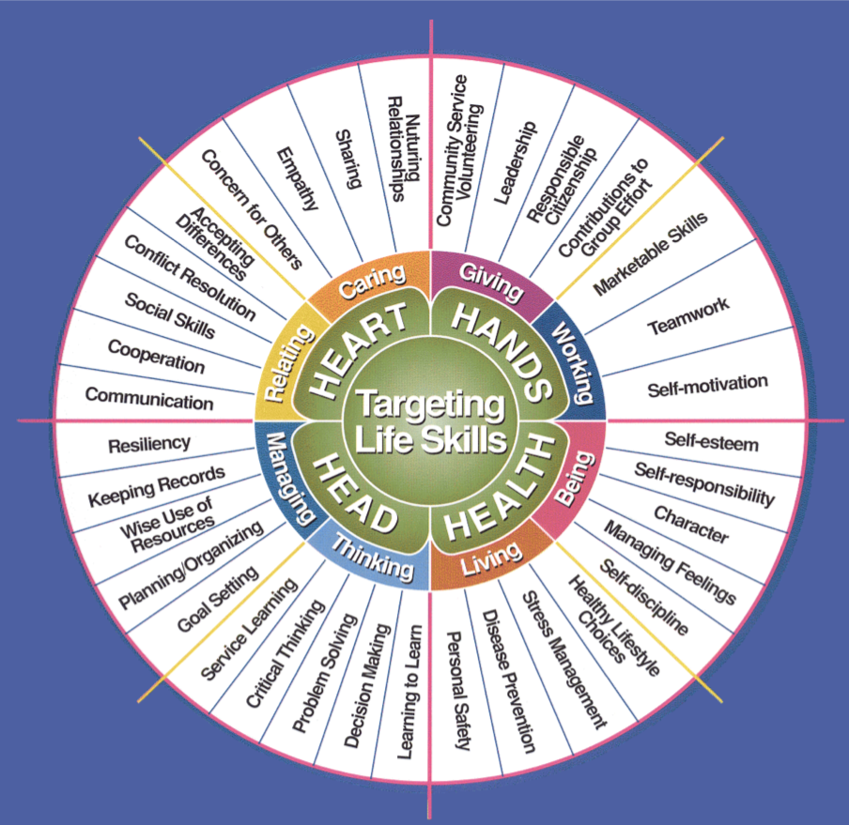
Notes:
Script notes:
4-H teaches life skills such as leadership, public speaking, decision making, empathy and many more.

Slide 15
The mission of the New Mexico 4-H Youth Development Program is to provide youth the opportunities to acquire leadership, citizenship, and life skills. New Mexico 4-H programs are based on the four concepts of positive youth development which are belonging, mastery, independence, and generosity.

Slide 16
“I like helping my community. It is important.”
John, Age 7, Dona Ana County Cloverbud
“I learned how to speak in front of people when I gave my demonstration. I learned about leadership, responsibility, taking care of animals, working hard and helping others in my community.”
Aubry, Age 10, Eddy County Novice
“Being a county diplomat has increased my leadership skills and my level of 4-H activities. It has improved my ability to interact with people I have never met before without getting nervous.”
Colton, Age 12, Valencia County Junior
“I have learned to be detailed oriented, manage my time and keep records. These skills have helped me to become self-motivated, independent, organized and confident.”
Hallie, Age 16, Rio Arriba County Senior
"NM 4-H Success Stories: Annual Report 2017”

Slide 17
To learn more about New Mexico 4-H continue to module:
New Mexico 4-H 101 - Part 2

